Slide 1

Reinforcement Learning
Q-Learning Approach to Play Pong
4th May 2020
Department of Mathematics
Manhattan College
Riverdale, NY
MATG 557 - Machine Learning
Presented By:
Michael Campiglia &
Anton Paljusevic

Slide 2
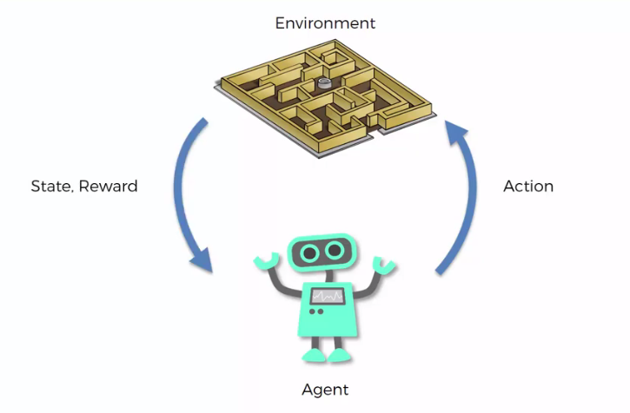
Introduction
Project Goal
Use the reinforcement learning technique of Q-learning to train an agent to perform well in the classic Atari game, Pong.
Reinforcement Learning (RL)
An agent tries to maximize reward when taking actions in an environment
Commonly modeled as a Markov decision process
Figure 1: General RL Cycle
Notes:
The goal of our project is to use the reinforcement learning technique of Q-learning to train an agent to perform well in the classic Atari game, Pong.

Slide 3
Q-Learning
Q-Learning
A reinforcement learning algorithm that seeks to find the best action to take given the current state and learn a “policy” that maximizes total reward.
Off-policy
The q-learning function learns from taking random actions (exploration)
A predefined policy, or set of behaviors, isn’t necessary for q-learning.

Slide 4
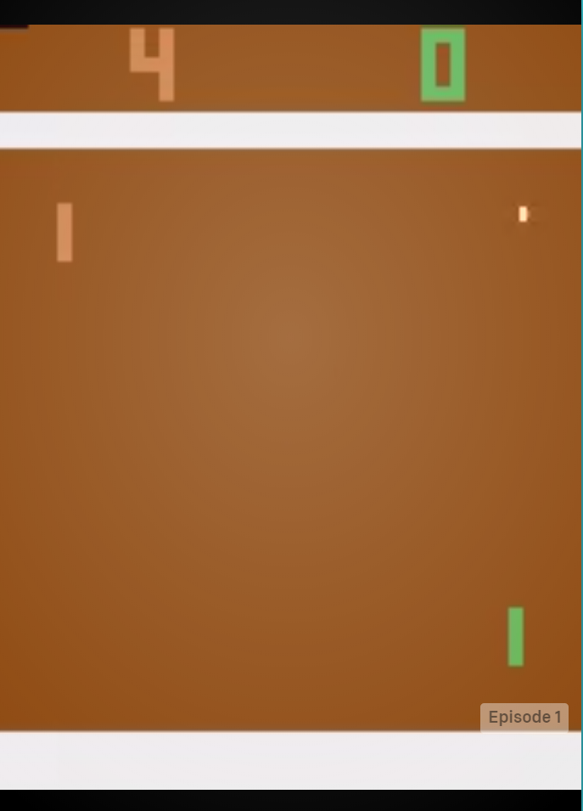
Data Exploration
GYM (an OpenAI RL package) to access a Pong Environment in Python
Observation Space: (training data) 210x160x3 RGB images
Action Space: 2 (move up), 5 (move down), 0 (do nothing)
Step: choose an action and enter new observation space
Episode: set of steps from beginning to end of game (21 points)
Reward: -1 (lose round), 0 (round still playing), 1 (win round)
Figure 2: Gym Pong Rendering

Slide 5
Model Training
The agent learns by taking an action at a specific state and then updating the associated Q-value in a Q-table
Matrix that contains all possible combinations of states and actions along with their “Q-value”
A “Q-value” is updated based on the reward given to the agent for performing a specific action at a specific state.
An agent can take an action in one of two ways
Reference the Q-table and choose the action with the highest q-value associated to the current state (exploitation)
Act completely randomly based on the available actions (exploration)
Notes:
Agent starts in a state (s1) takes an action (a1) and receives a reward (r1)
Agent selects action by referencing Q-table with highest value (max) OR by random (epsilon, ε)
Update q-values

Slide 6
Model Training
Updating Q-value
NewQ(s,a) = Q(s,a) + 𝛼[R(s,a) + 𝛾 maxQ’(s’,a’) - Q(s,a)]
Associated Python Code
Q[state, action] = Q[state, action] + lr * (reward + gamma * np.max(Q[new_state, :]) - Q[state, action])
Notes:
Lr = learning rate (alpha) defines how much you accept the new value vs the old value
Gamma = discount factor. Determines how much you want future reward to matter compared to current reward (usually ranges between 0.8 and 1.0, with 1 putting all weight towards future reward.
Reward = value received after completing certain action and specific state (given by gym)

Slide 7
Proof of Concept
Programed q-learning algorithm to solve a simpler environment
CartPole:
Goal is to balance a stick
Observation space is 4 readings of velocities and locations
Reward is a point for every step without dropping it
Figure 3: CartPole 30 Episodes of Training
Figure 4: CartPole 300 Episodes of Training
Notes:
Parameter tuning was extremely important in learning speed

Slide 8
Data Preprocessing
Observation states affect the size of the Q-Table. Compressing and discretizing decreases the possible number of states.
Compression
Reduce observation space from 210 X 160 X 3 array to 1 X 3 array
Opponent's paddle , ball, and agent’s paddle location retrieved by searching for pixel color in array
Discretization
Take the compressed array and change max and min range for locations

Slide 9
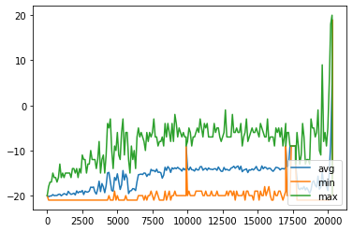
Testing and Validation
Conducted throughout the process of training by tracking average performance every 100 episodes.
Further proof can be seen by rendering games with the resulting Q-Table. (next slide)
Figure 5: Number of Training Episodes vs. Performance
Notes:
Graph plateaus at -15 average
then exploration (epsilon) is reset at 17,000 episodes
Average jumps up and agent learns to exploit
Winning with

Slide 10
Agent Progress
Performance with no training
Performance after 20,000 episodes of training

Slide 11


It Worked!
Notes:
Possible solutions for q-learning:
Run training for a longer period of time
Restart training on a trained q-table (resets learning and exploration rate)
Adjust reward system to mimic pole cart
OR just switch to deep q-learning:
Add a neural network to preprocess the observation space
Allows the agent to learn to cluster similar scenarios and learn quicker

Slide 12
Summary
Proved q-learning could “solve” a simple environment (CartPole)
On more complex environments (Pong) parameter tuning is more difficult due to training time
Resetting parameters and starting with a trained q-table increases performance
Future Work
Continue/Automate Parameter tuning
Transition to Deep Q-learning
Notes:
Possible solutions for q-learning:
Run training for a longer period of time
Restart training on a trained q-table (resets learning and exploration rate)
Adjust reward system to mimic pole cart
OR just switch to deep q-learning:
Add a neural network to preprocess the observation space
Allows the agent to learn to cluster similar scenarios and learn quicker

Slide 13
References
Dutta, Sayon. Reinforcement Learning with TensorFlow: A beginner's guide to designing self-learning systems with TensorFlow and OpenAI Gym. Packt Publishing Ltd, 2018.
“Getting Started With Gym” Gym, OpenAI, 16 April 2020, https://gym.openai.com/docs/
“Pong-v0” Gym, OpenAI, 16 April 2020, https://gym.openai.com/envs/Pong-v0/
Violante, Andre. “Simple Reinforcement Learning: Q-Learning.” Towards Data Science, Towards Data Science, 18 Mar. 2019, towardsdatascience.com/simple-reinforcement-learning-q-learning-fcddc4b6fe56.
Dimitrakakis, Christos, and Ronald Ortner. "Decision making under uncertainty and reinforcement learning." (2018).

Slide 14

Full Video

